Slide 1
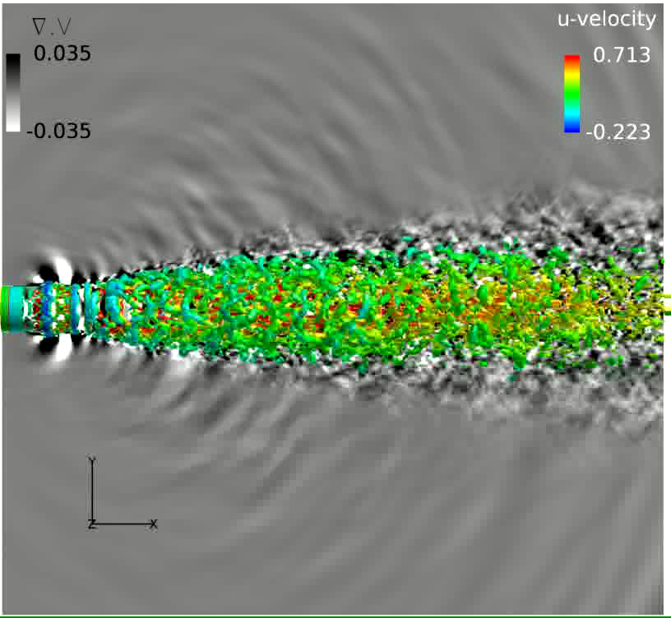
Overall Goal
Study coherent structures and how they contribute to noise
Investigate excitation frequency effects
Notes:
-Overall goal is to use small perturbations to control the jet to study the period coherent structure that the excitation creates and see how that affects the noise in the near acoustic field.
-Here is a phased average representation of the process. We excite the jet causing a vortical ring to form which influences the surrounding near field sound.
-To analyze the flow field we will be using phase-averaging, like this movie, auto-correlations which is the correlation of a point to itself, and 2 point correlation which is how two points in the flow field correlate to each other.

Slide 2
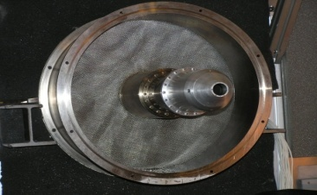
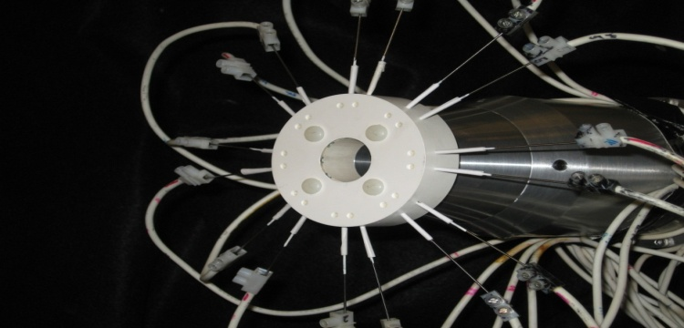
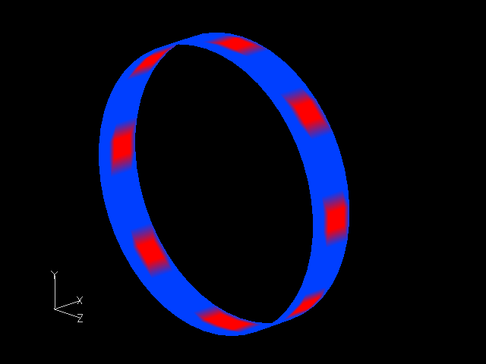
Shear Layer Excitation Method
Ohio State University Experiments (Samimy, Adamovich et al)
Jet flow
M=0.9
Re=0.64E6
Diameter=2.54x10⁻² m
Advantages of plasma actuators:
Rapid on/off: low inertia
switched off when not in use
non-intrusive
high bandwidth
Axisymmetric (m=0) mode
Excitation Frequencies Explored:
St=fD/U=0.05
St=0.15
St=0.25
LAFPA: Localized Arc Filament Plasma Actuators
Notes:
get rid of jet flow. Plasma model is same as in blah it is a surface heating model shown how accurate…

Slide 3
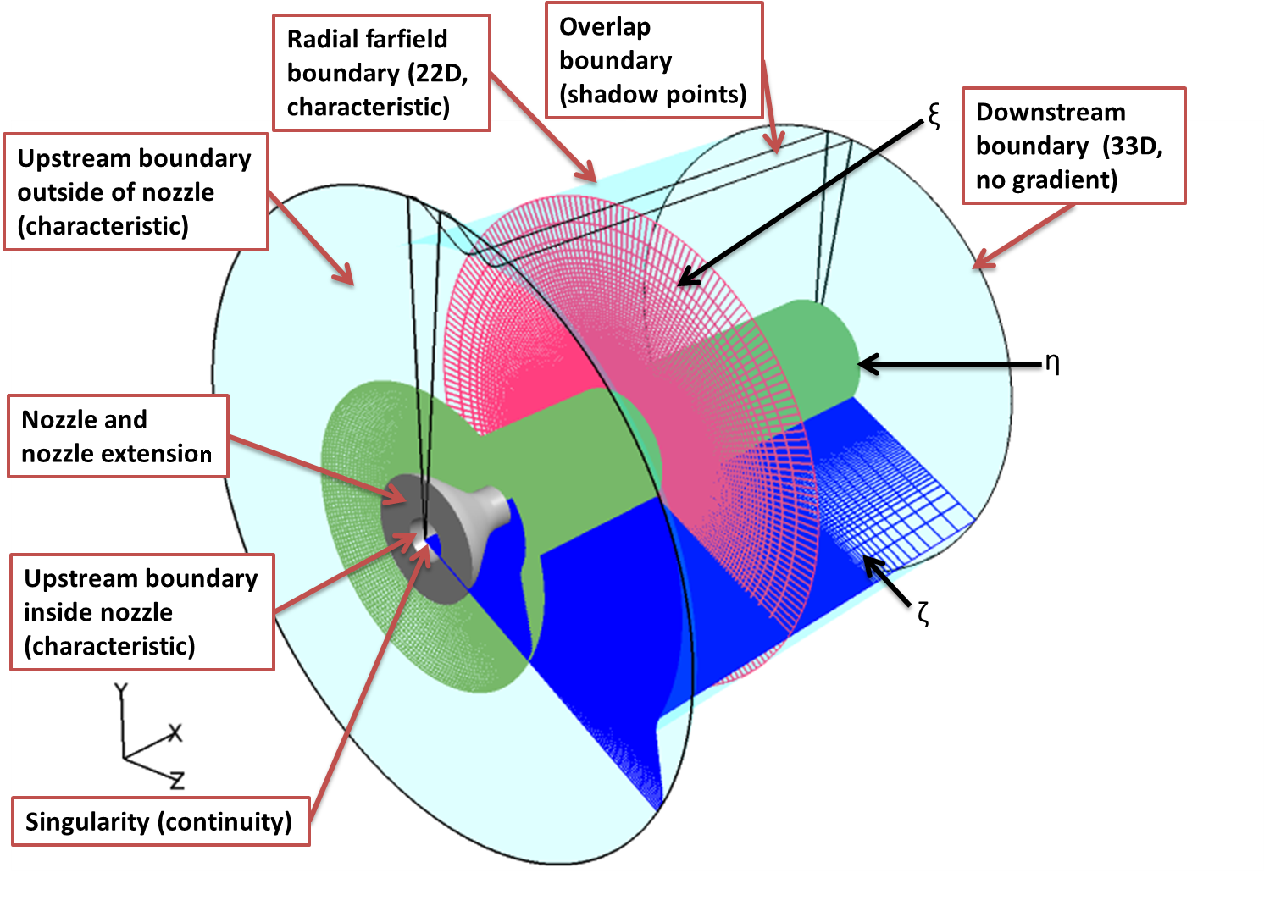
Numerical Method
Mesh Topology & Boundary Conditions
FDL3DI
Full Navier Stokes Equations
3rd Order Upwind Biased Roe
Van Leer Harmonic Limiter
Implicit 2nd order diagonalized approximately factored Beam Warming algorithm
65 million point mesh
Notes:
Take m=1.3 out or make it animated

Slide 4
Method
Ohio State University Experiments (Samimy, Adamovich et al)
Jet flow
M=0.9 and 1.3
Re=0.64E6 and 1.07E6
Diameter=2.54x10⁻² m
Advantages of plasma actuators:
Rapid on/off: low inertia
switched off when not in use
non-intrusive
high bandwidth
Axisymmetric (m=0) mode
FDL3DI
Full Navier Stokes Equations
3rd Order Upwind Biased Roe
Van Leer Harmonic Limiter
Implicit 2nd order diagonalized approximately factored Beam Warming algorithm
LAFPA: Localized Arc Filament Plasma Actuators
Notes:
get rid of jet flow. Plasma model is same as in blah it is a surface heating model shown how accurate…

Slide 5
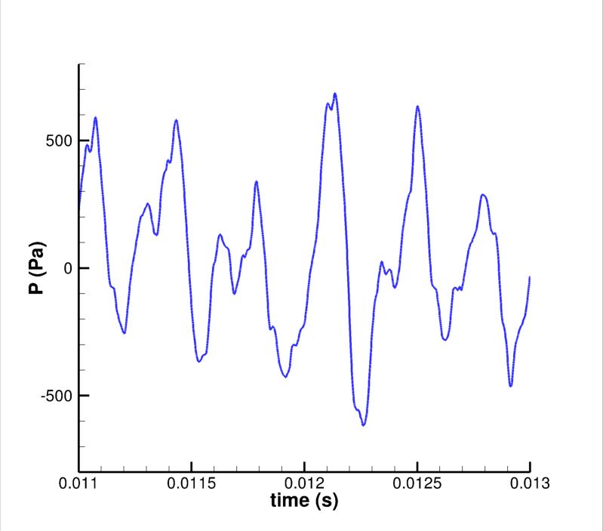
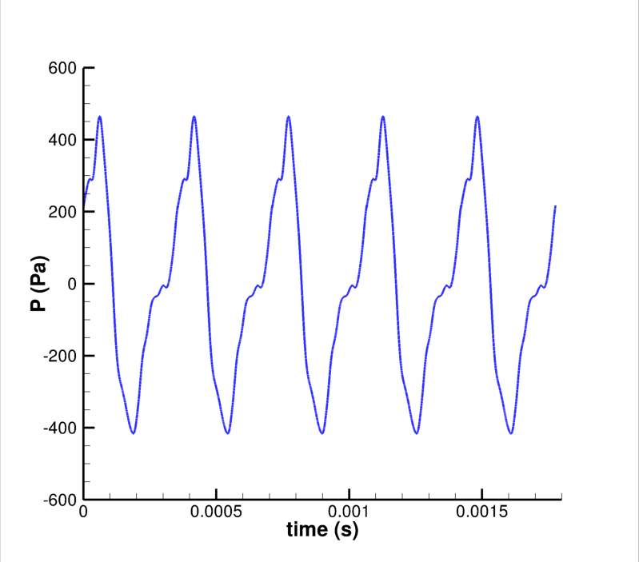
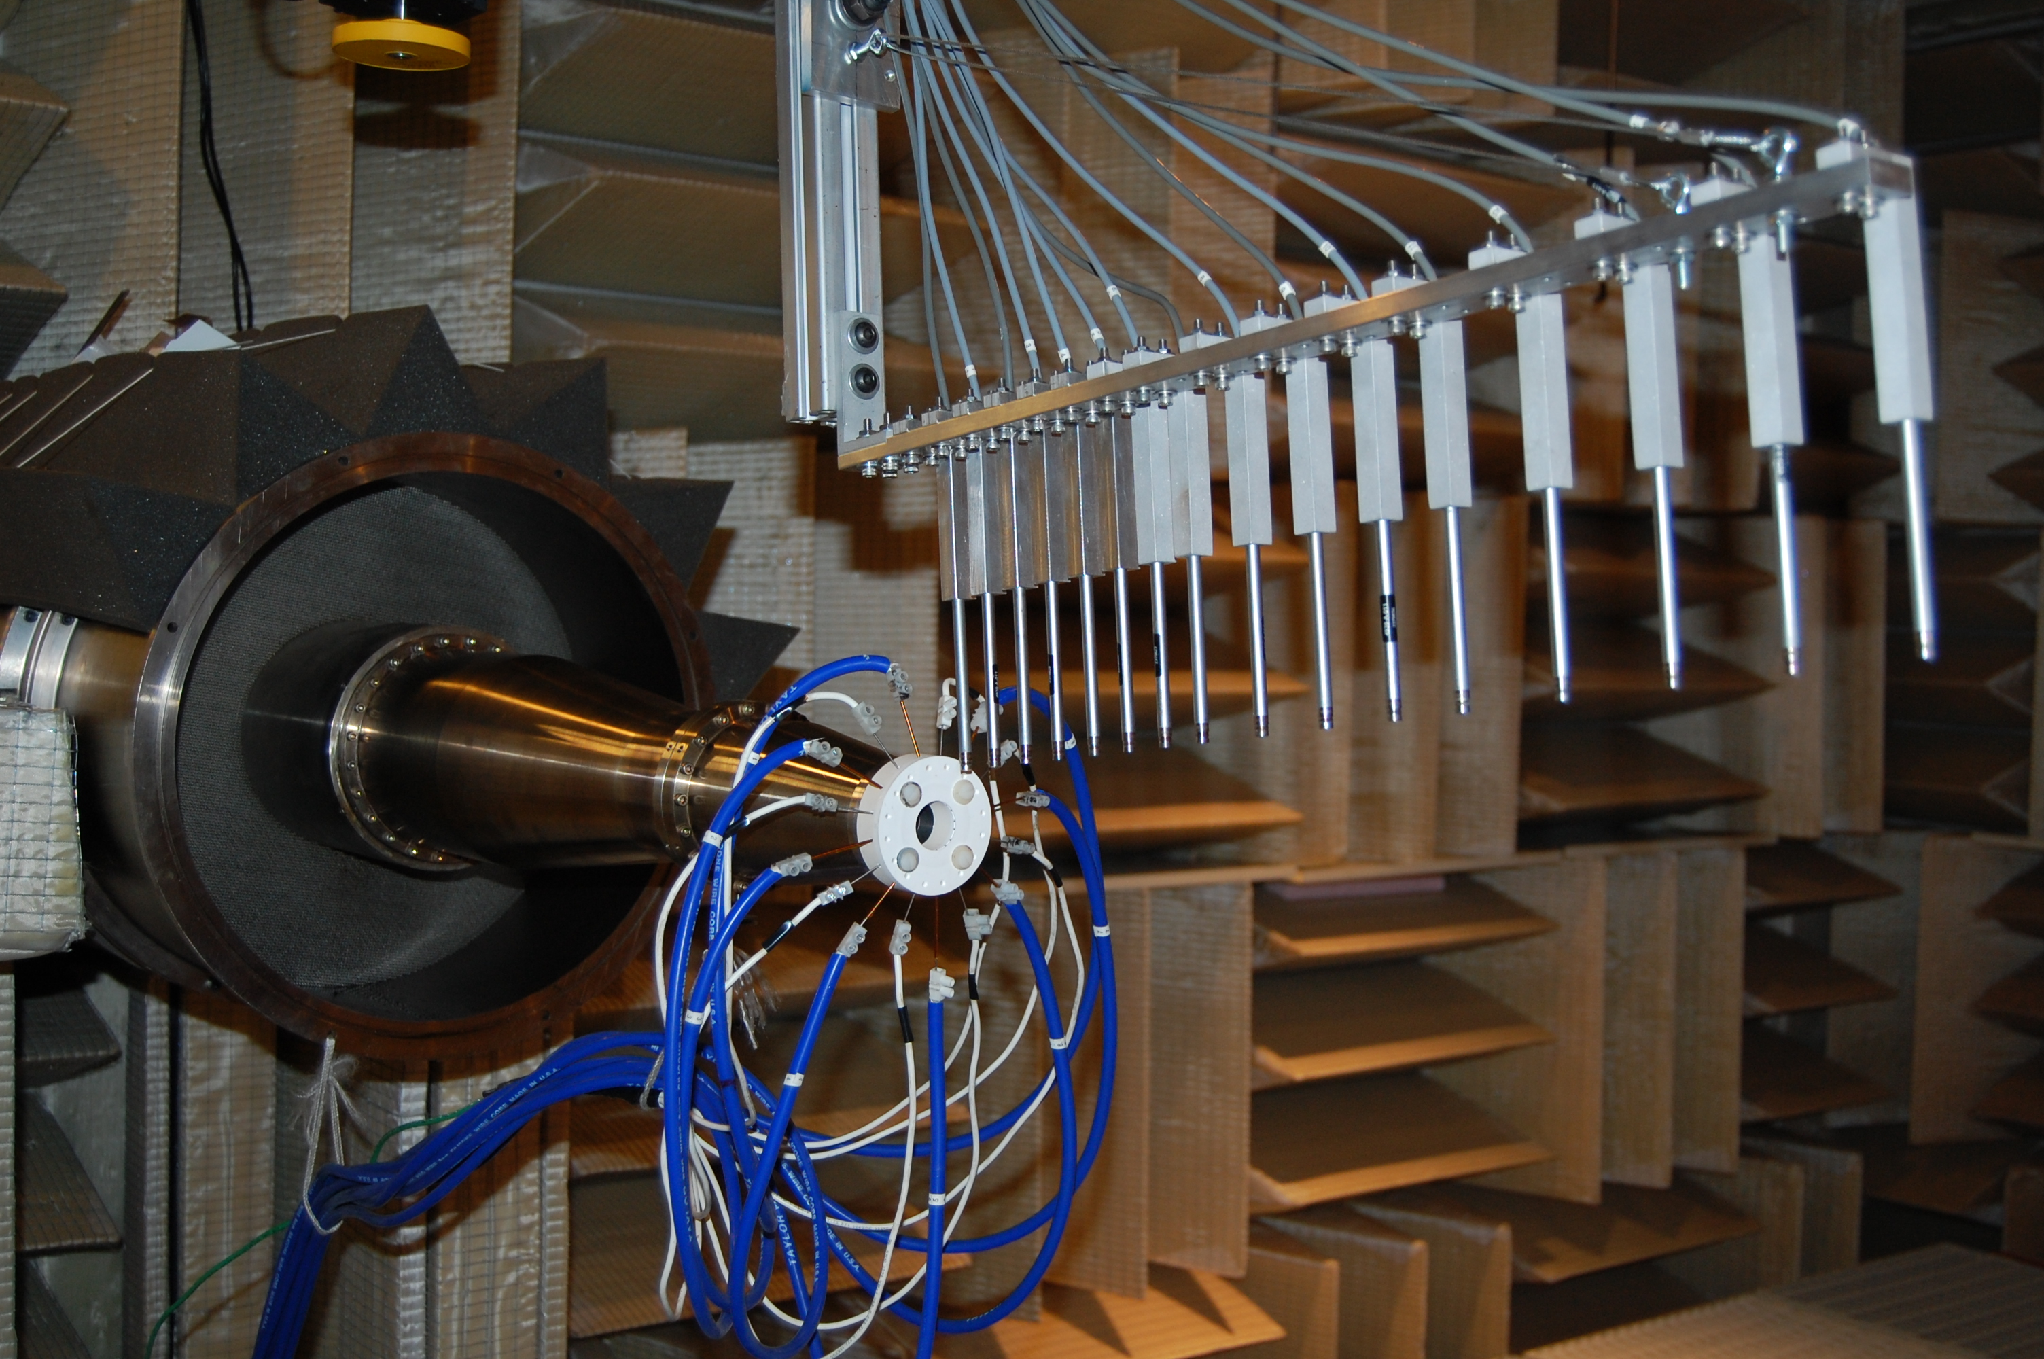
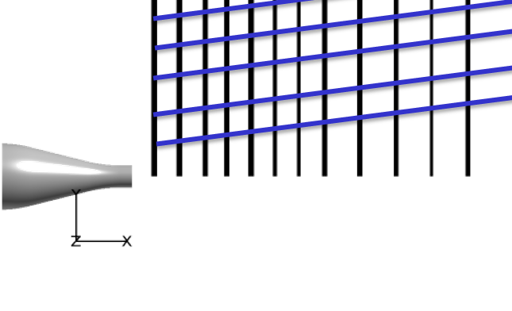
Connecting the Near Field to the Coherent Structures
Instantaneous
Phase Averaged
Experiments can only measure with one array at a time in the near field
Therefore, they cannot connect the structures (PIV) within the jet to the near field (array) in an instantaneous manner

Slide 6
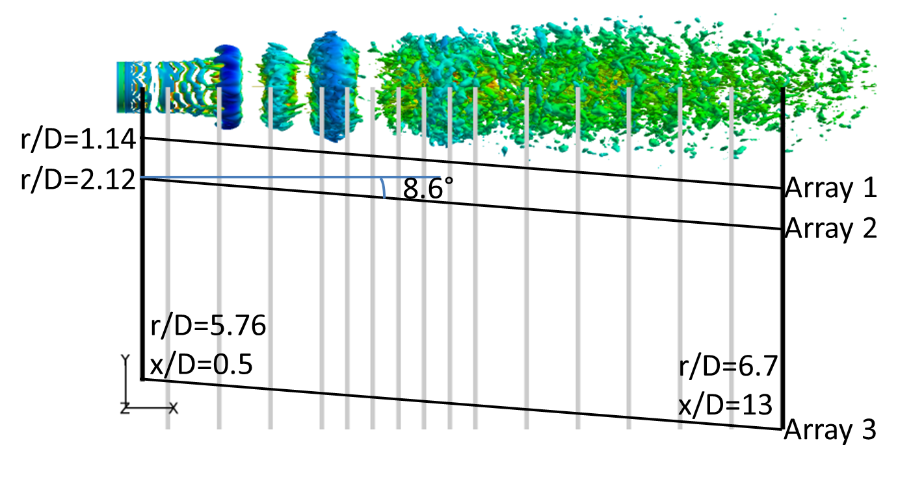
Near Field Pressure Probe Locations
Points were placed to mimic Mach 0.9 experiment array locations
Notes:
We collected pressure data along each of these three arrays which line up with experimental array positions. Array 3 represents the near acoustic field while Array 1 has hydrodynamic waves.
Let’s specificly look at Array 1 at these three locations first.

Slide 7
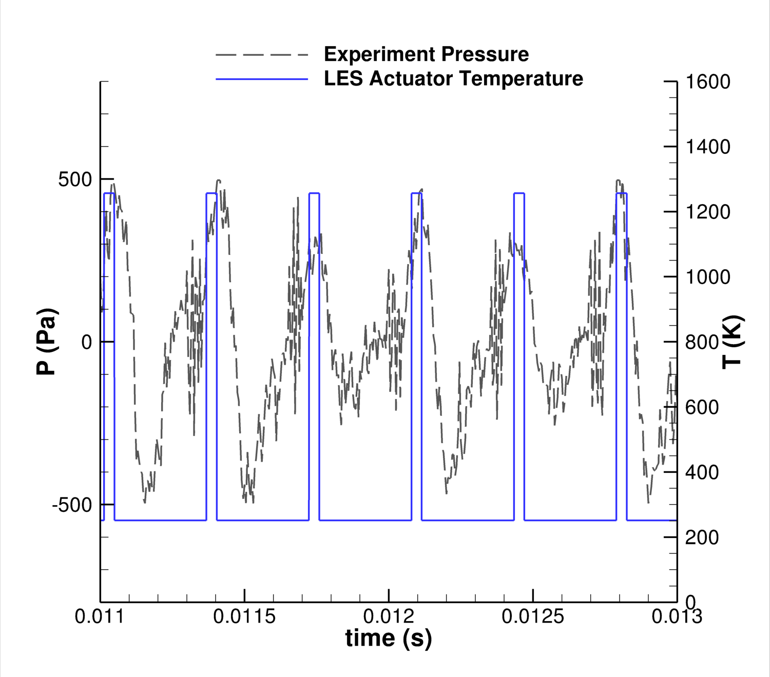
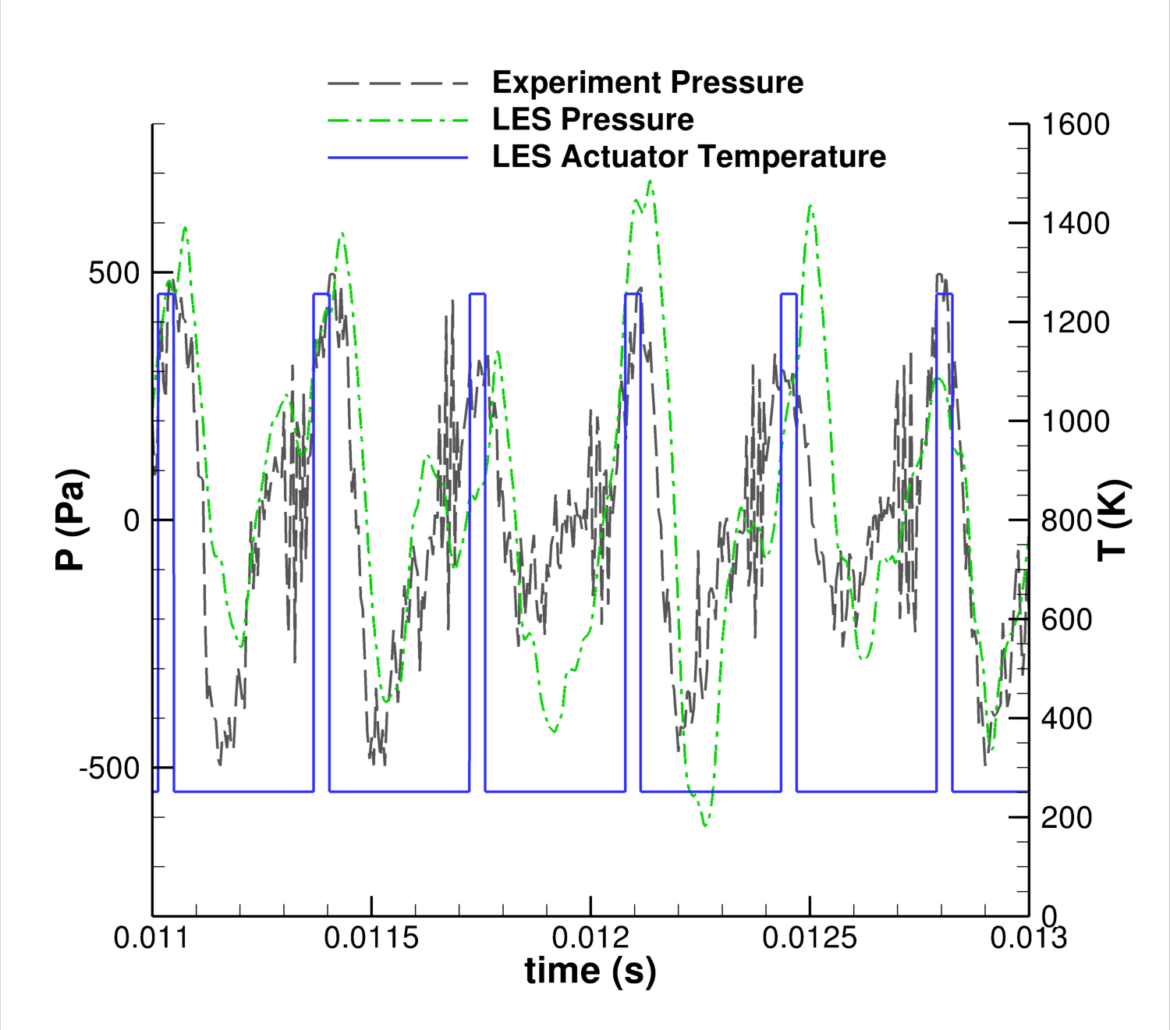
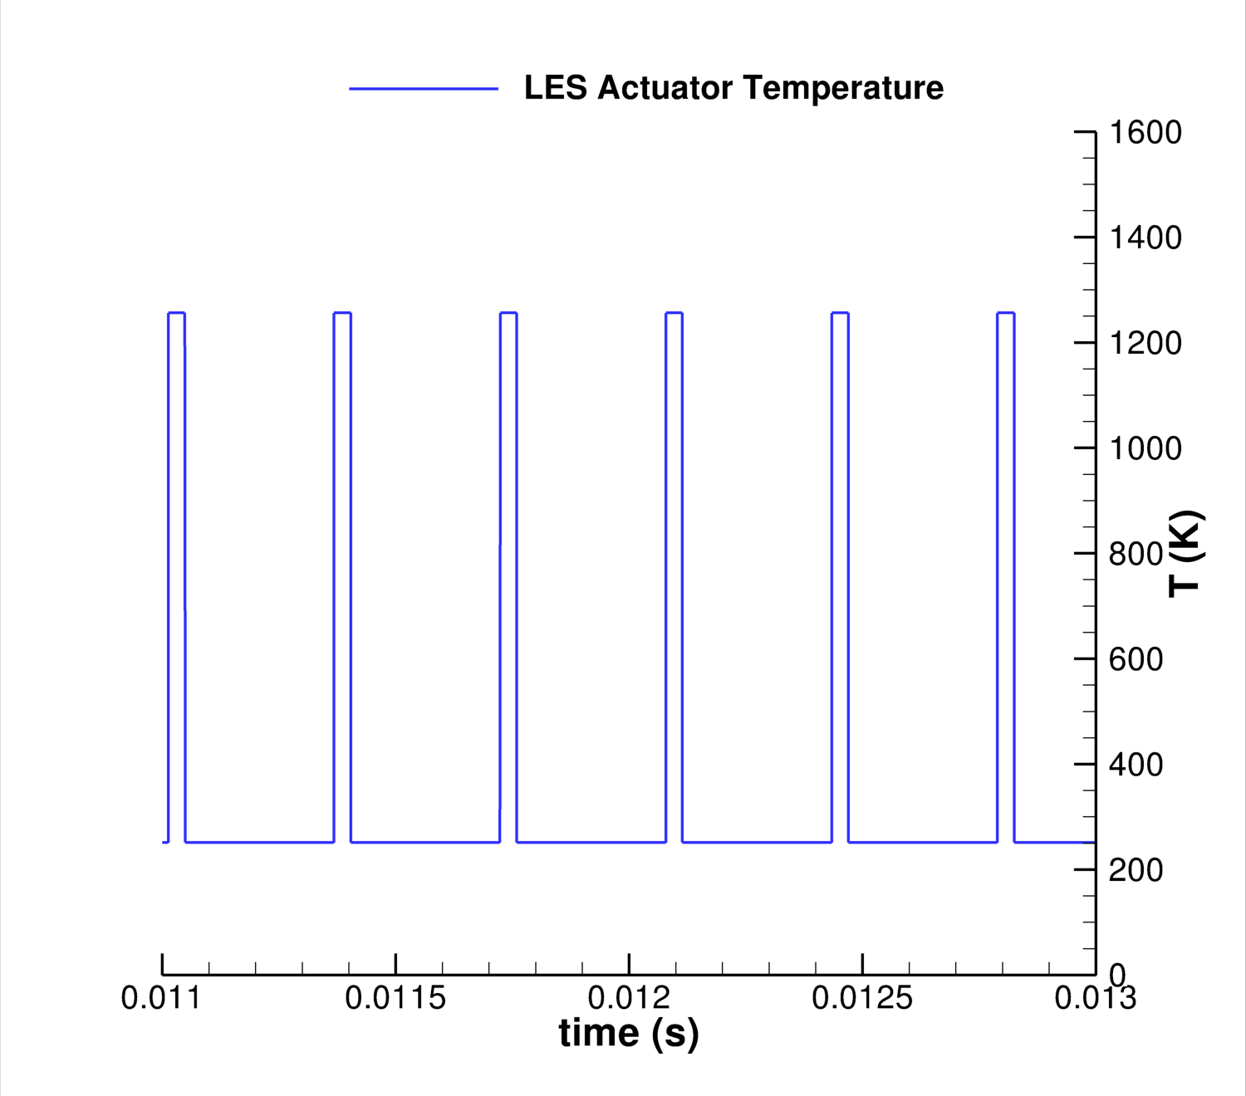
Comparison with Experiment
M=0.9, St=0.25
Response in jet is linked to actuator event
Notes:
Actuation structures dependent on the moel that you use

Slide 8
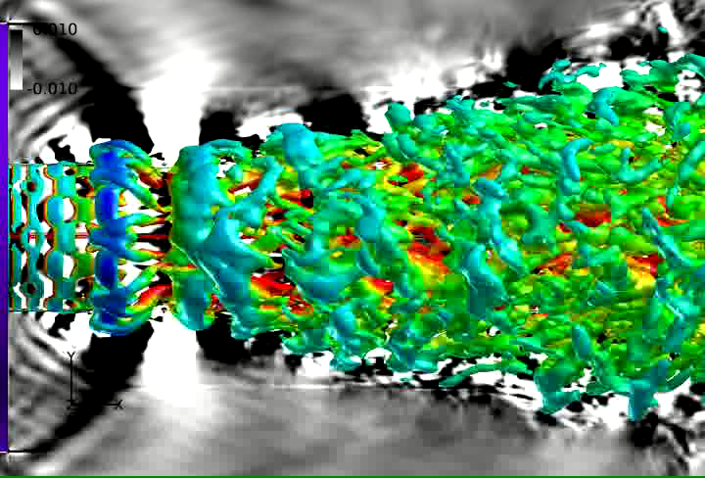
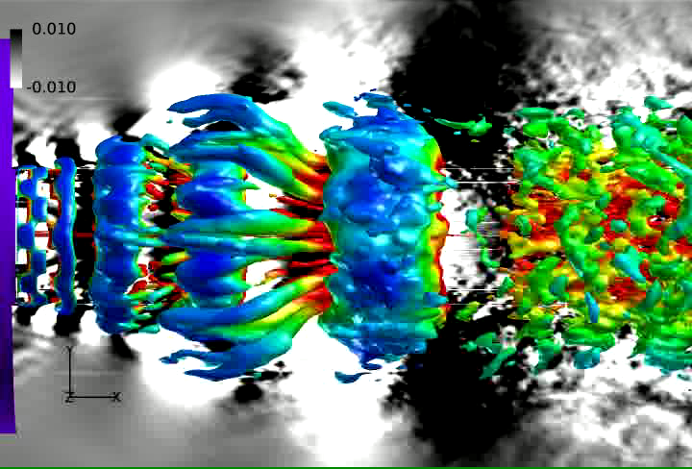
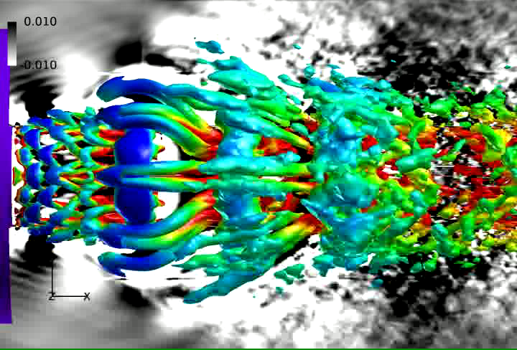
Phase Averaged Jet Structures and Near Field Response: Effect of frequency
St=0.05
St=0.15
M=0.9
For St=0.05, structures never interact (impulse response)
Same structures are seen in the higher frequencies with mostly linear interactions
Hairpin vortices have been linked to entrainment and help cause the destruction of the coherent rings
St=0.25
Notes:
Do one mach with all frequencies maybe

Slide 9
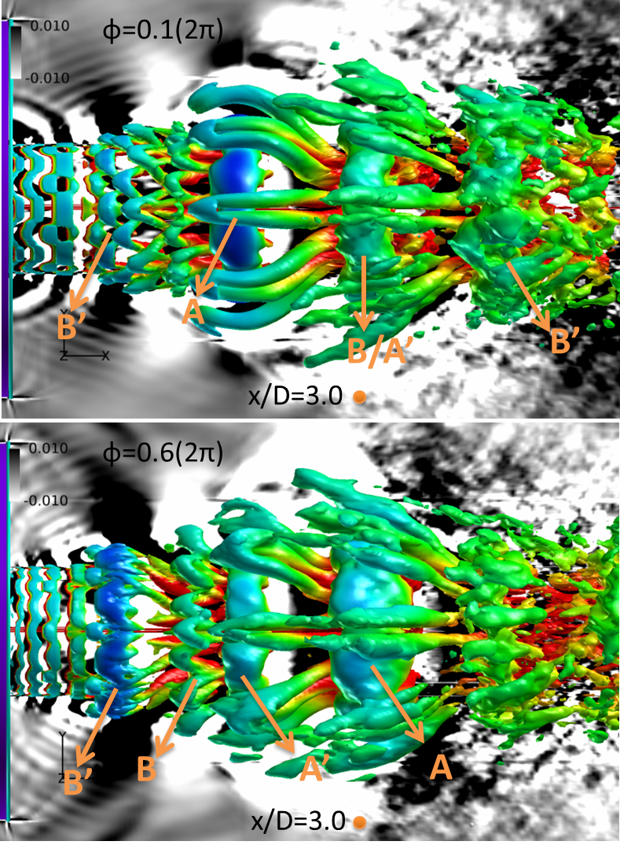
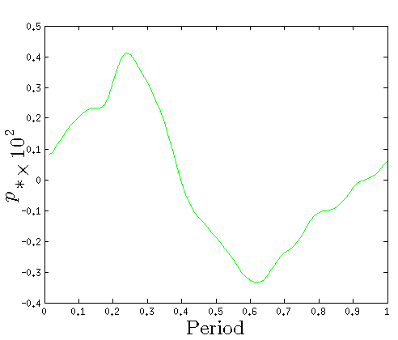
St=0.25

Slide 10
Governing Equations: Full 3-D Navier-Stokes
Spatial Scheme
Upwind
MUSCL (3rd order)
Van Leer Harmonic Limiter
Viscous: Centered
Continuity
Momentum
Time Integration
Approximately Factored Implicit
Sub-iteration strategy
2nd order accurate
Energy
Turbulence model
Implicit LES

